Slide 1
FrauDetector: A Graph-Mining-based Framework for Fraudulent Phone Call Detection
Speaker: Jim-An Tsai
Advisor: Professor Jia-ling Koh
Author:Vincent S. Tseng, Jia-Ching Ying, Che-Wei Huang, Yimin Kao, Kuan-Ta Chen
Date:2016/6/6
Source: KDD ’15

Slide 2
Outline
Introduction
Method
Experiment
Conclusion

Slide 3
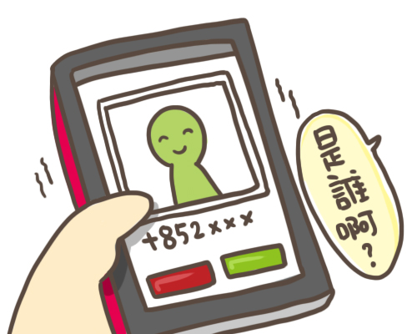
Who is calling?
Fraud?
Normal?
OR

Slide 4
Behavior of users who receive a call

Slide 5
Anti-fraud mobile app

Slide 6
FrauDetector

Slide 7
Outline
Introduction
Method
Experiment
Conclusion

Slide 8
Trust Value Mining
To support weighted HITS algorithm, we proposed two kinds of directed graph.
1. UPG(User-remote_phone_number graph)
2. CPG(Contact_book-remote phone number graph)
To represent behavior of users’ telecommunications.

Slide 9
UPG

Slide 10
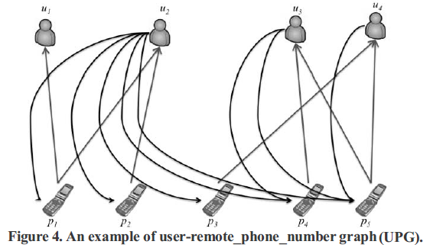
UPG
UPG = (V, E)

Slide 11
CP

Slide 12
CPG

Slide 13
Weights Assignment
User usually has call to/from normal remote phone number either frequently or for a while.
So explore the telecommunication behaviors in two different but complementary aspects:
1. Duration Relatedness (DR) between user and remote phone number
2. Frequency Relatedness (FR) between user and remote phone number.

Slide 14
Conditional Telecommunication Record Set( CT )
Example:

Slide 15
Duration Relatedness (DR)
Our goal is to extract duration relatedness features for pairs of users and remote phone numbers.
Propose to extract two duration features to depict relation between users and remote phone numbers.
1. Total Call Duration (TCD)
2. Average Call Duration (ACD)

Slide 16
TCD
Aggregating user’s call duration of a remote phone number can be used to infer the probability that a user trusts that remote phone number.
Example:
The total call duration from p5 to u4 is (17:30:08 − 17:12:33) + (20:40:08 − 20:02:28) = (00:17:35) + (00:37:40) = 3315 (sec.)

Slide 17
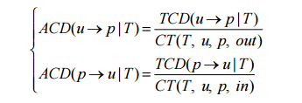
ACD
Averaging user’s call duration of a remote phone number can adjust this bias evaluation.
Example:
The average call duration from p5 to u4 is 3315/2 = 1657.5 (sec.)

Slide 18
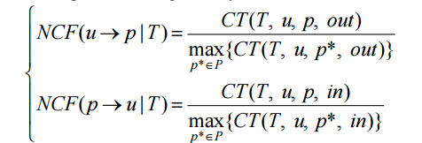
Frequency Relatedness
Our goal is to extract frequency relatedness feature for pairs of users and remote phone numbers.
Example:
The normalized call frequency from p5 to u4 is 2/3.

Slide 19
Trust Value Learning
Perform a Weighted HITS algorithm to learn trust value for each remote phone number and experience value for each user

Slide 20
HITS-BASED FRAUDULENT REMOTE PHONE NUMBER DETECTION
After learning trust value and experience value, we must estimate the trust value of unknown remote phone number based on the learned trust value and experience value.

Slide 21
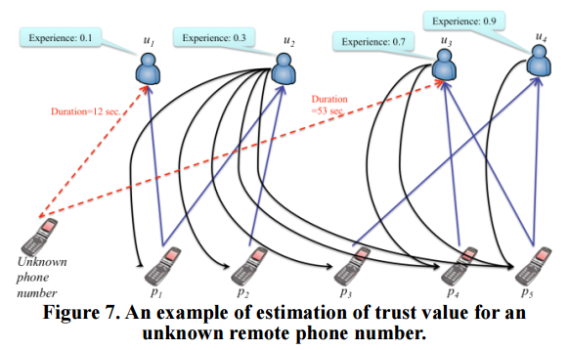
HITS-BASED FRAUDULENT REMOTE PHONE NUMBER DETECTION
Example:

Slide 22
Outline
Introduction
Method
Experiment
Conclusion

Slide 23
Dataset

Slide 24
Performance Metrics

Slide 25
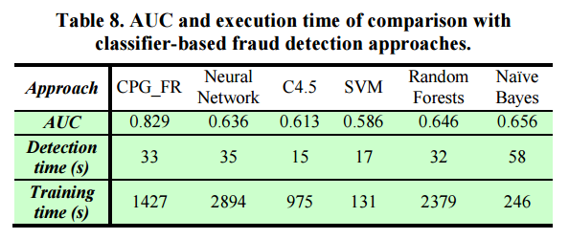
Compare with Baseline approaches

Slide 26
Outline
Introduction
Method
Experiment
Conclusion

Slide 27
Conclusion
This paper have proposed a novel framework named HITS-based fraudulent phone call detection (FrauDetector) for detecting fraudulent phone calls by mining users’ telecommunication records.
Tackled the problem of mining trust value from telecommunication activity, which is a crucial prerequisite for fraud detection.

